Slide 1
EAD, Visualization, Clustering and Prediction by Decision Tree of Beijing Airbnb Dataset
Tianyi Li, Jiaqi Yang
2019/12/08

Slide 2
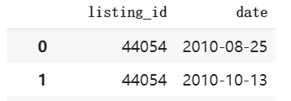
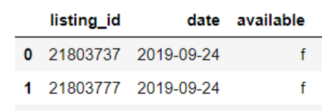
Description of Data
The data was sourced from the Inside Airbnb website. We chose the dataset in Beijing China.
The dataset mainly consists of three files:
Listings
Reviews
Calender
There are over a hundered attributes in the datasets. We selected sixteen attributes for the analysis.

Slide 3
Some Interesting Facts
34,745 unique listings in the dataset from the earlist on Aug. 6th 2010 to the latest on Sep. 9th 2019
Over 250,000 reviews have been written
The prices ranges from ￥28 to ￥71597 per night.

Slide 4
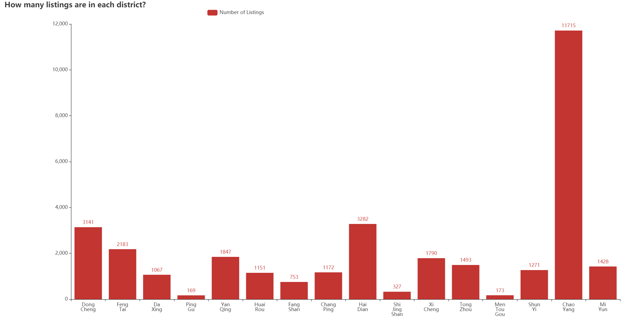
Number of Listings

Slide 5
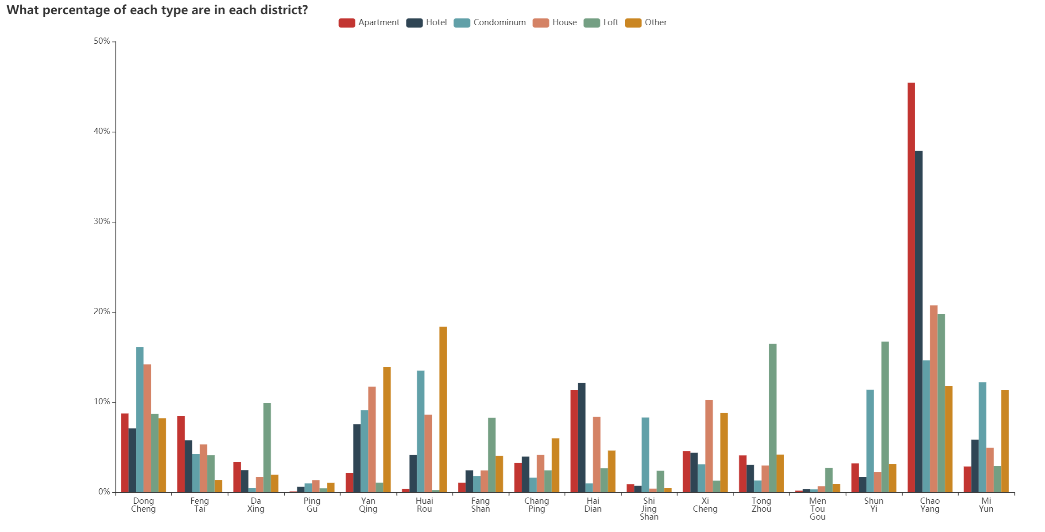
Types of Listings in Beijing

Slide 6
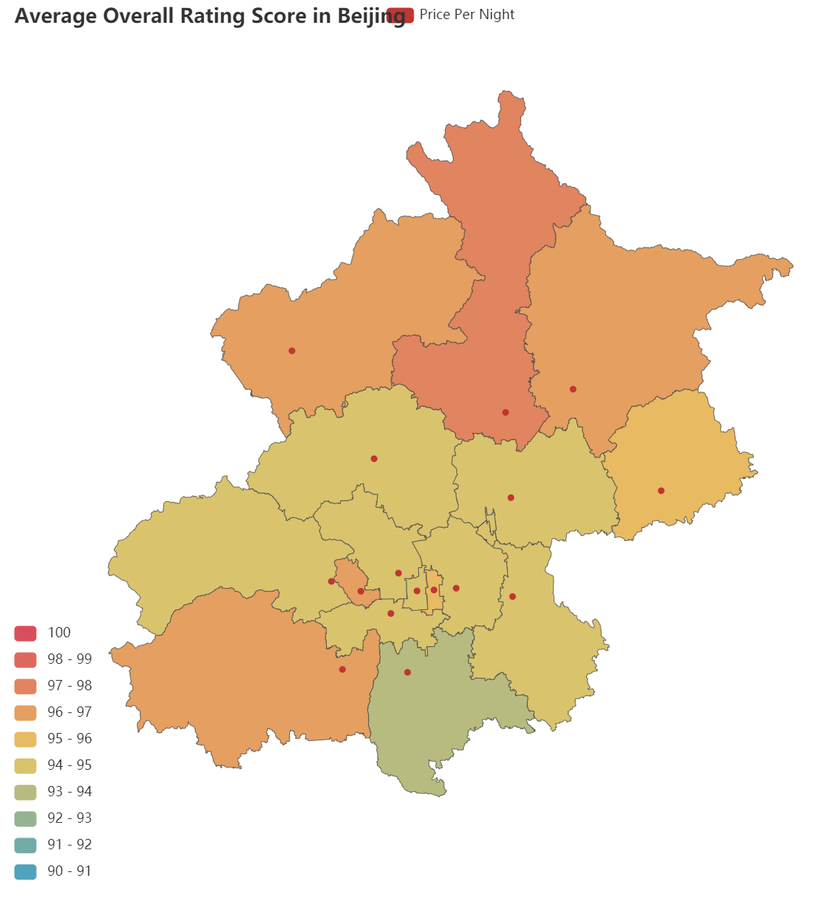
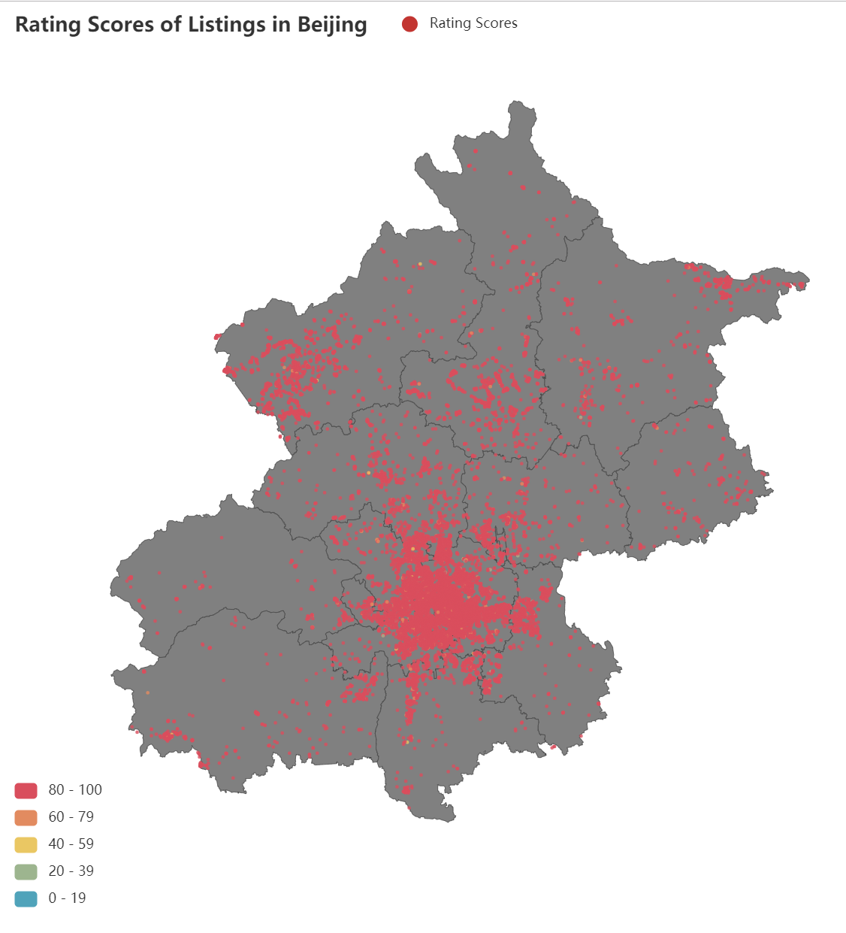
Rating Scores

Slide 7
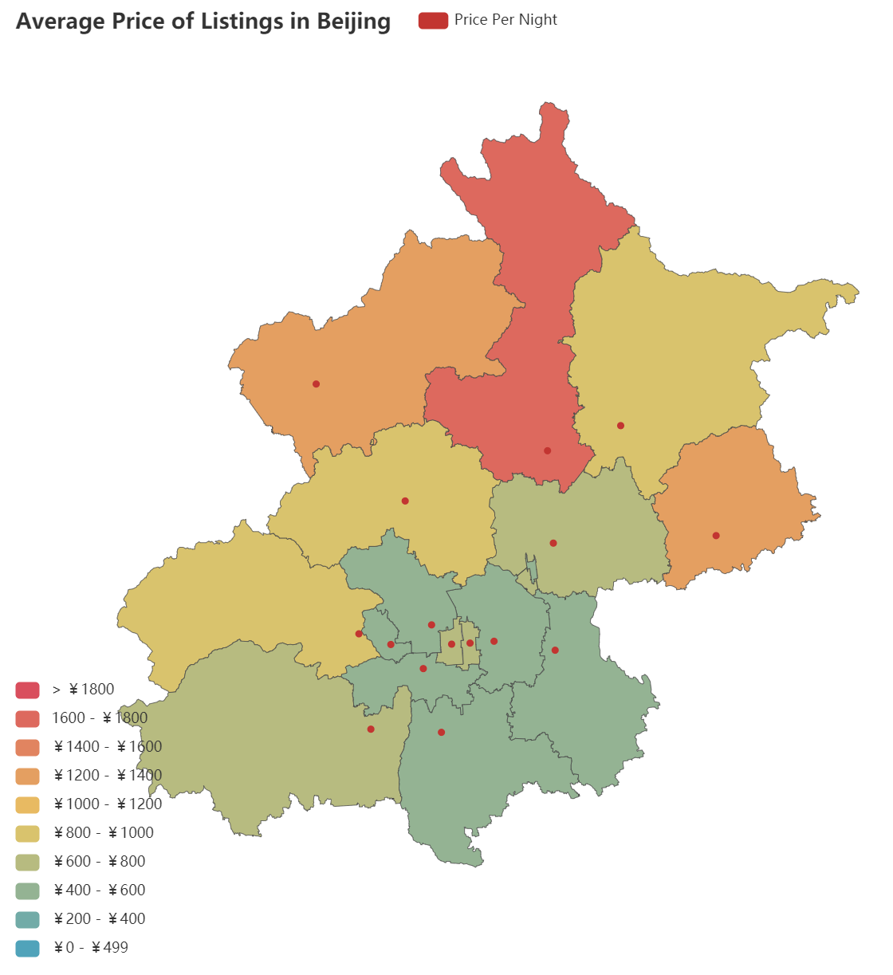
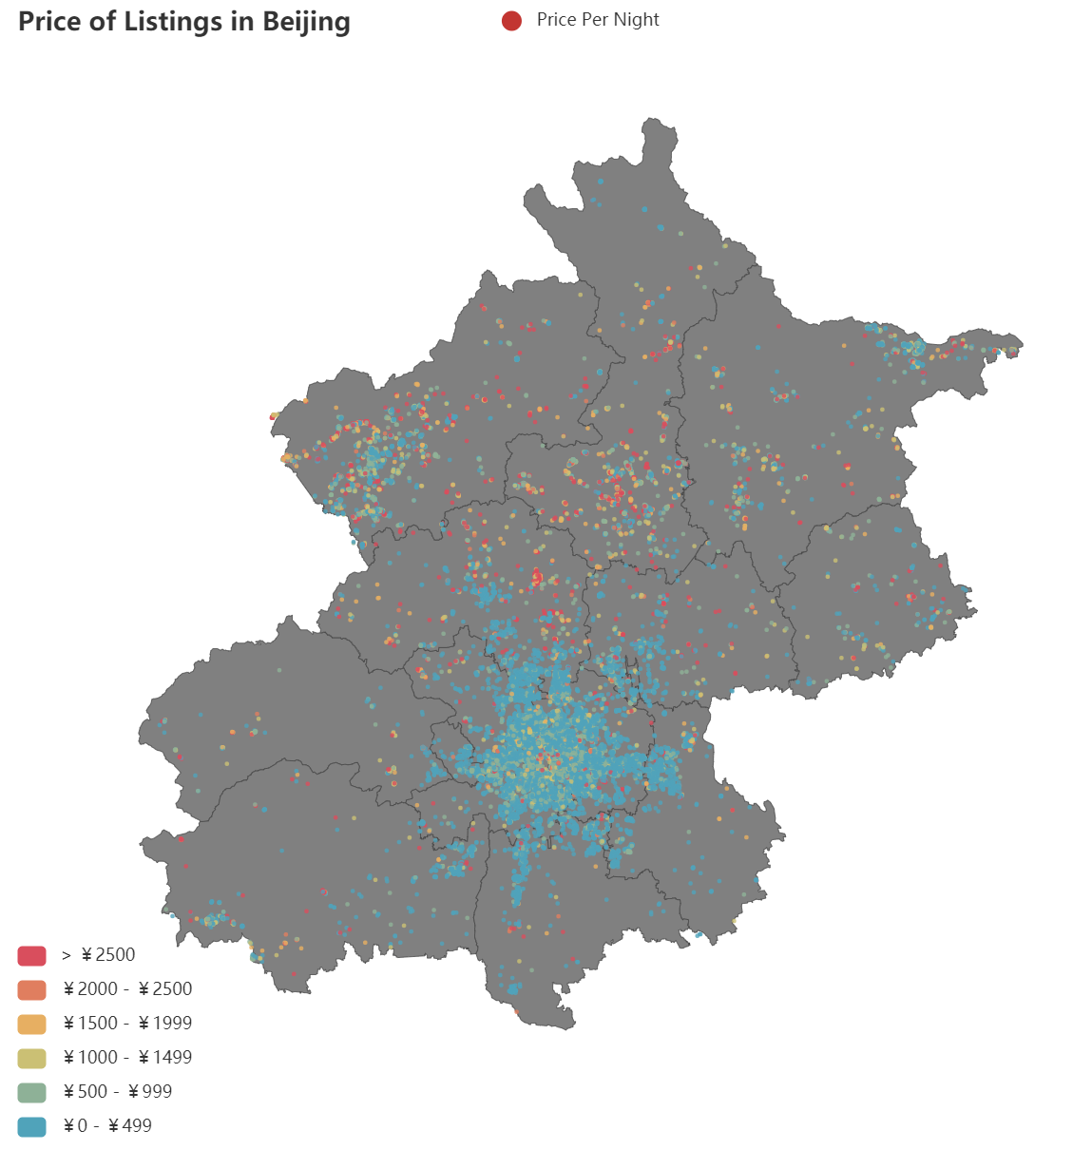
Price of Listing

Slide 8
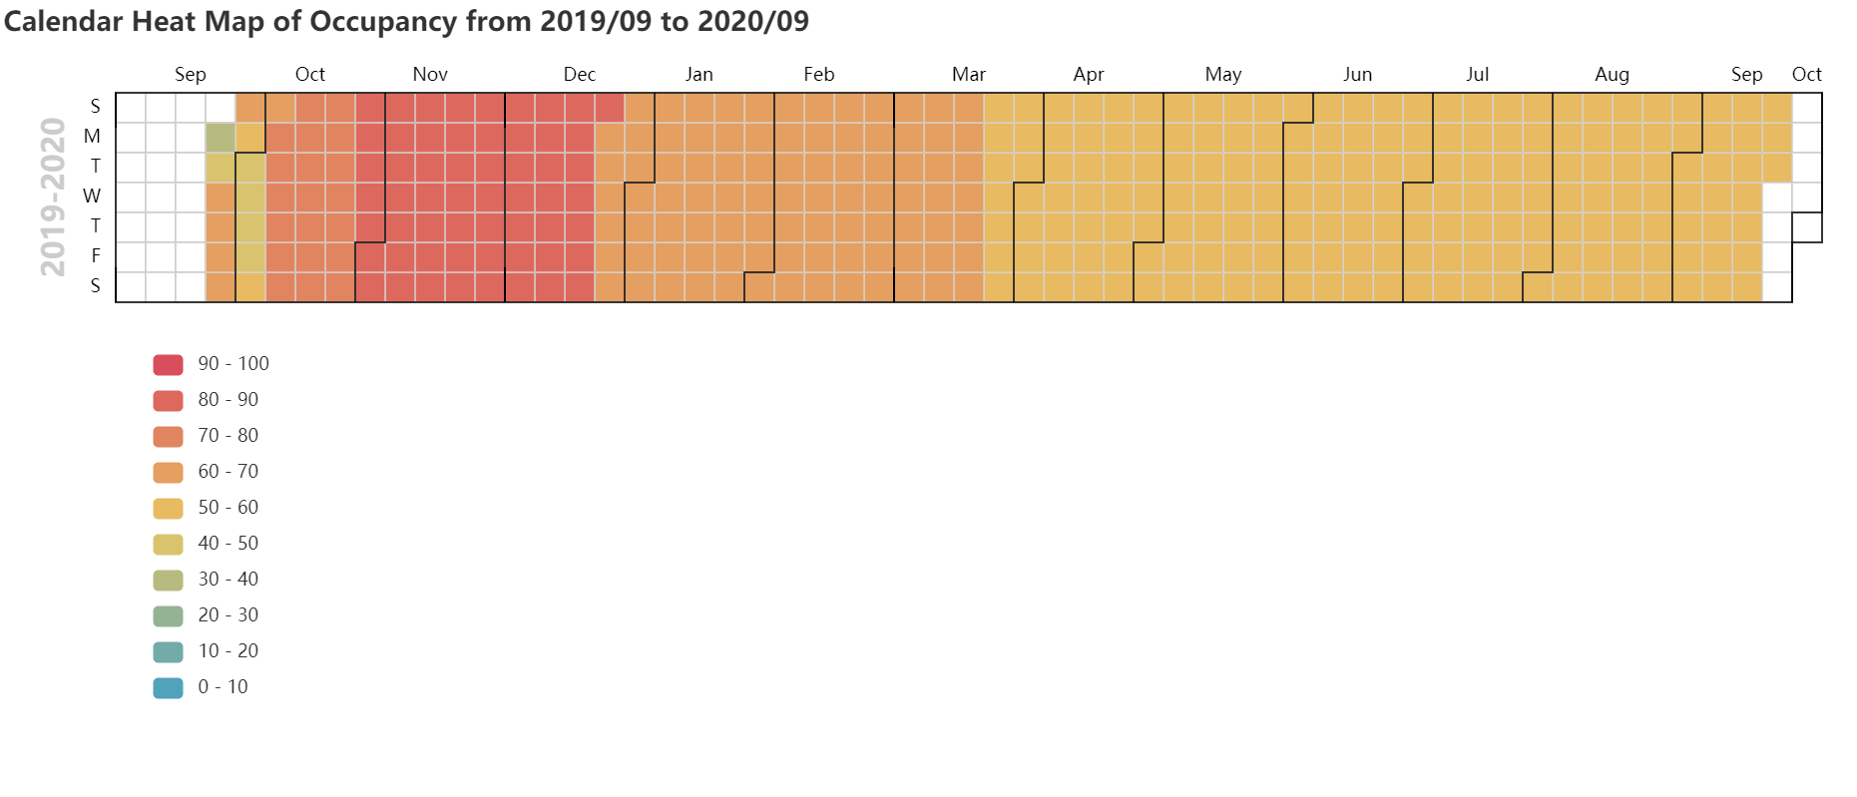
Occupancy Rate

Slide 9
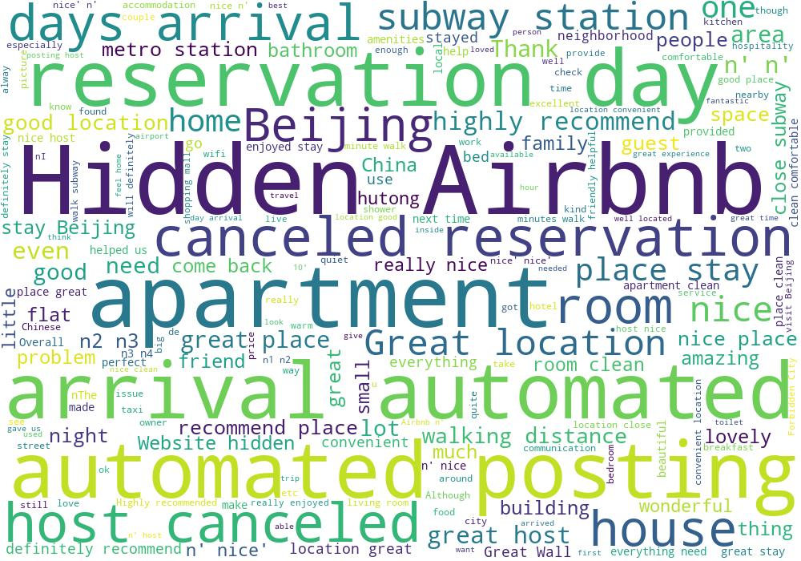

Word Cloud

Slide 10
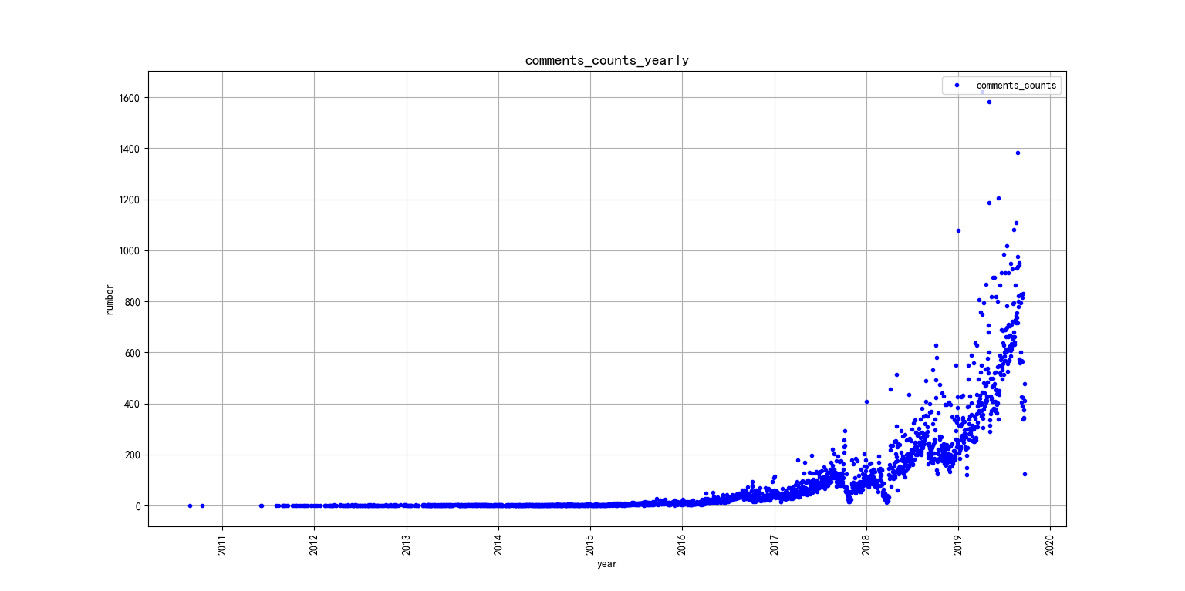
Increasing number of reviews
We can see hugh increase in the number of reviews over the years, which indicates an increase in the demand.

Slide 11
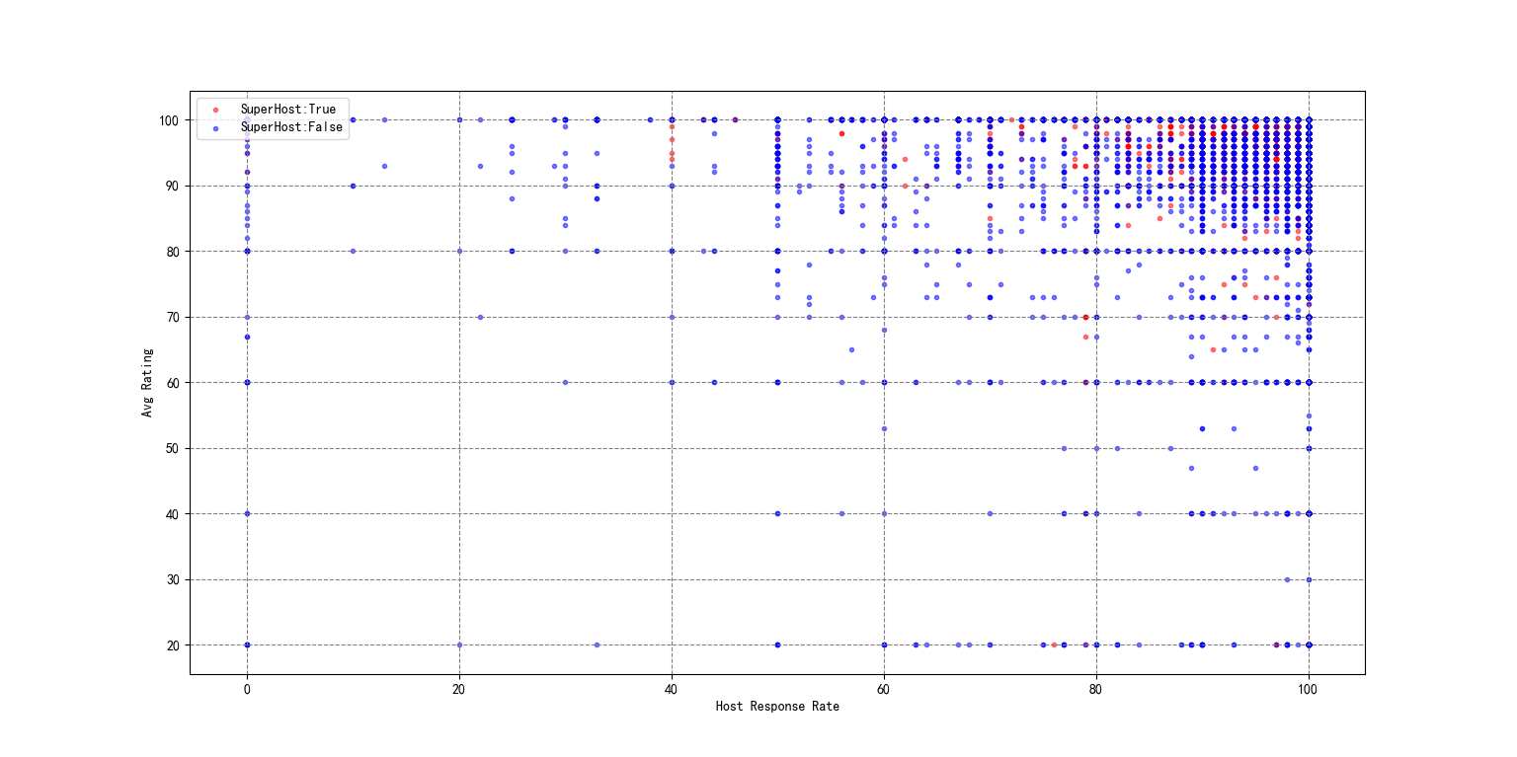
How to be a superhost

Slide 12
Decision Tree
We want to do a Decision Tree to predict the price of apartments.
Attributes we choose:
'property_type','room_type','bed_type','cancellation_policy','host_identity_verified','neighbourhood_cleansed','host_is_superhost','bathrooms','bedrooms','beds','security_deposit','cleaning_fee','review_scores_rating','review_scores_accuracy','review_scores_cleanliness','review_scores_checkin','review_scores_communication','review_scores_value','review_scores_location','reviews_per_month','host_response_rate','extra_people','amenities'
Method we choose：
Some null value filled with mean value, delete some null value sample, delete symbol such as $
model：sklearn，DecisionTreeRegressor(criterion='mse',max_depth=10)
Evaluation Standard: Mean Absolute Deviation

Slide 13
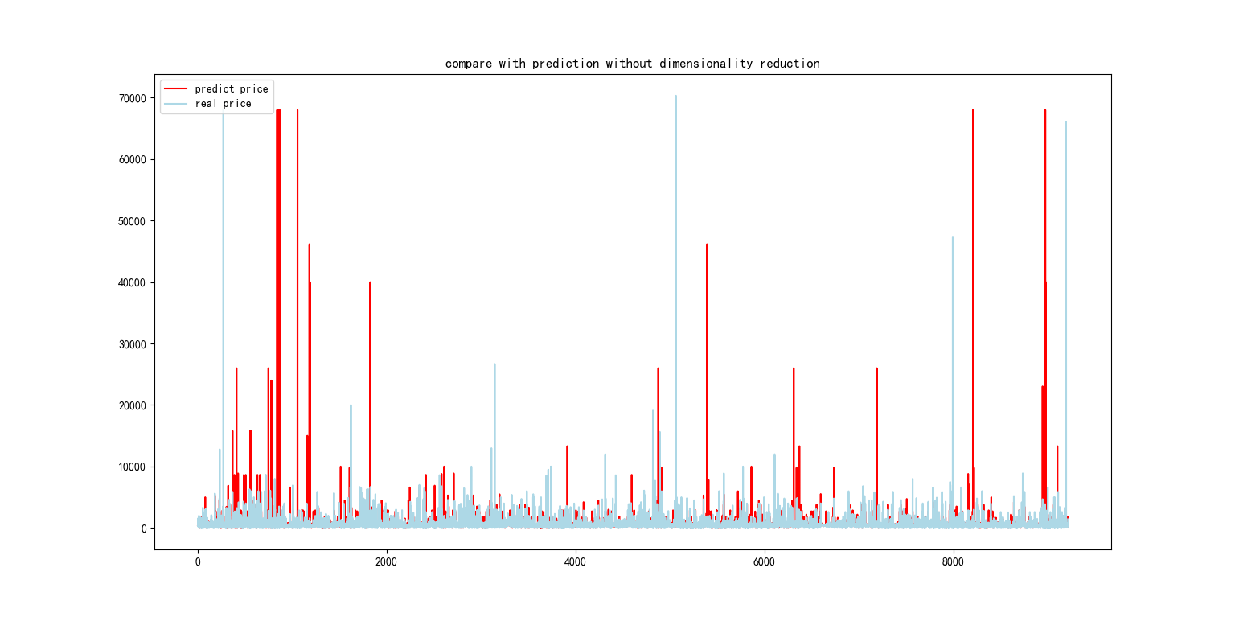
visualization :
Graph of compare real with prediction
price of prediction
price of real
Mean Absolute Deviation: 474

Slide 14
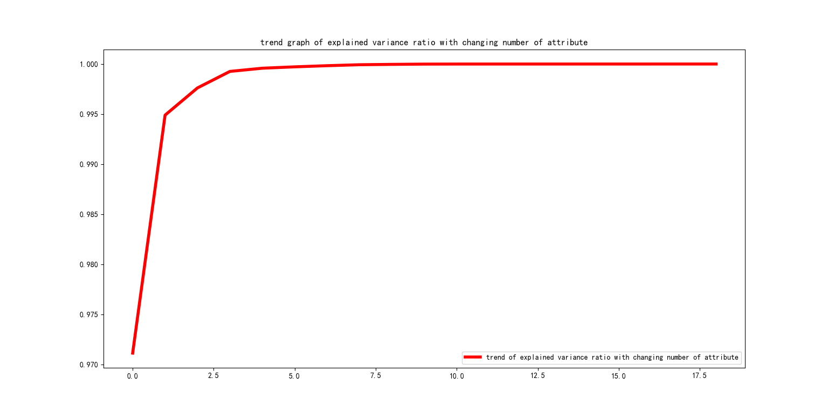
Reducing dimension
improving：
reducing dimension，PCA(n_components=i,svd_solver='full')
for i in range(1,20):
find the best number of the attribute dimension
Evaluation Standard:
explained variance ratio

Slide 15
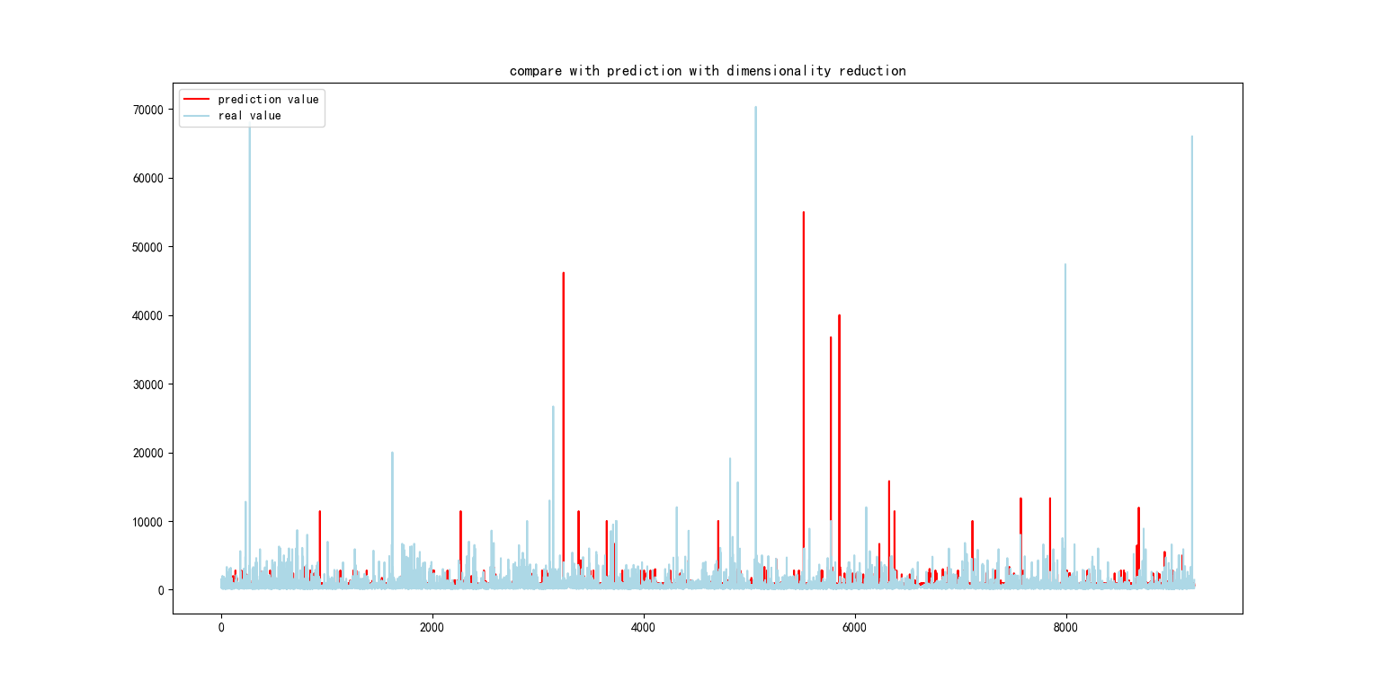
trend graph of explained variance ratio with changing number of attribute
When number of the attribute dimension is 8 or so，it stop to rise and become a horizontal line. Thus, we choose 8 in Decision Tree again.
Mean Absolute Deviation: 541
Limitation:
some useful attributes are lost in dimension reduction
detailed preprocessing is necessary

Slide 16
Clustering
We want to do a clustering to differentiate various type of apartments.
Attributes we choose:
'accommodates','price','review_scores_accuracy','review_scores_cleanliness','review_scores_checkin','review_scores_communication','review_scores_location','review_scores_value','beds','bedrooms'
Method we choose：
Some null value filled with mean value; K Means;

Slide 17
Evaluation Standard: Silhouette Coefficient
Test different number (from 2 to 7) of clusters
visualization :
Graph of Silhouette Coefficient trend with changing number of clustering
X axis = area; Y axis = price per night

Slide 18
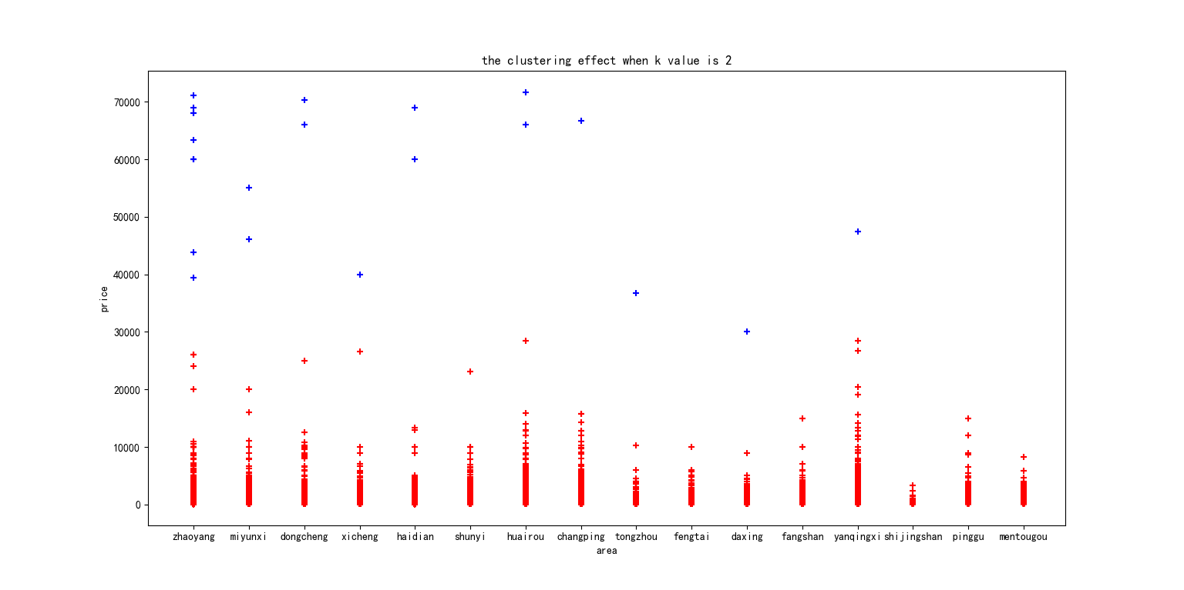

Slide 19
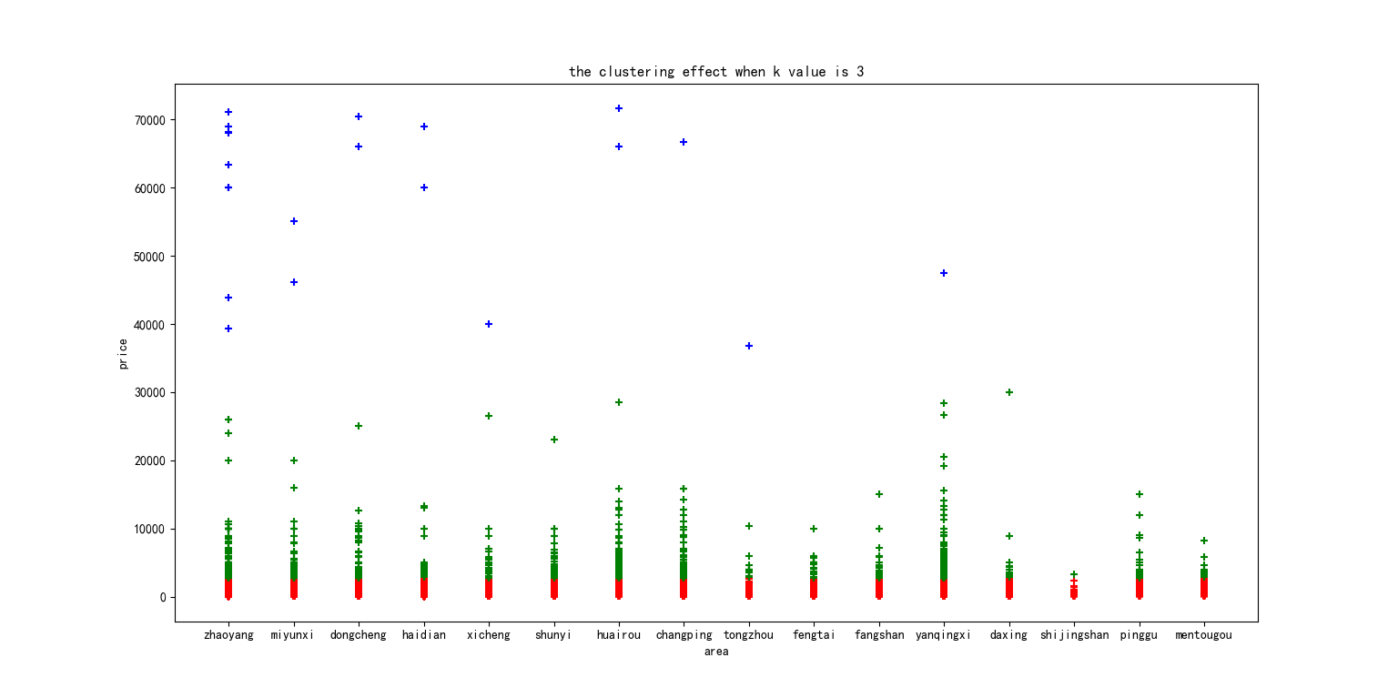

Slide 20
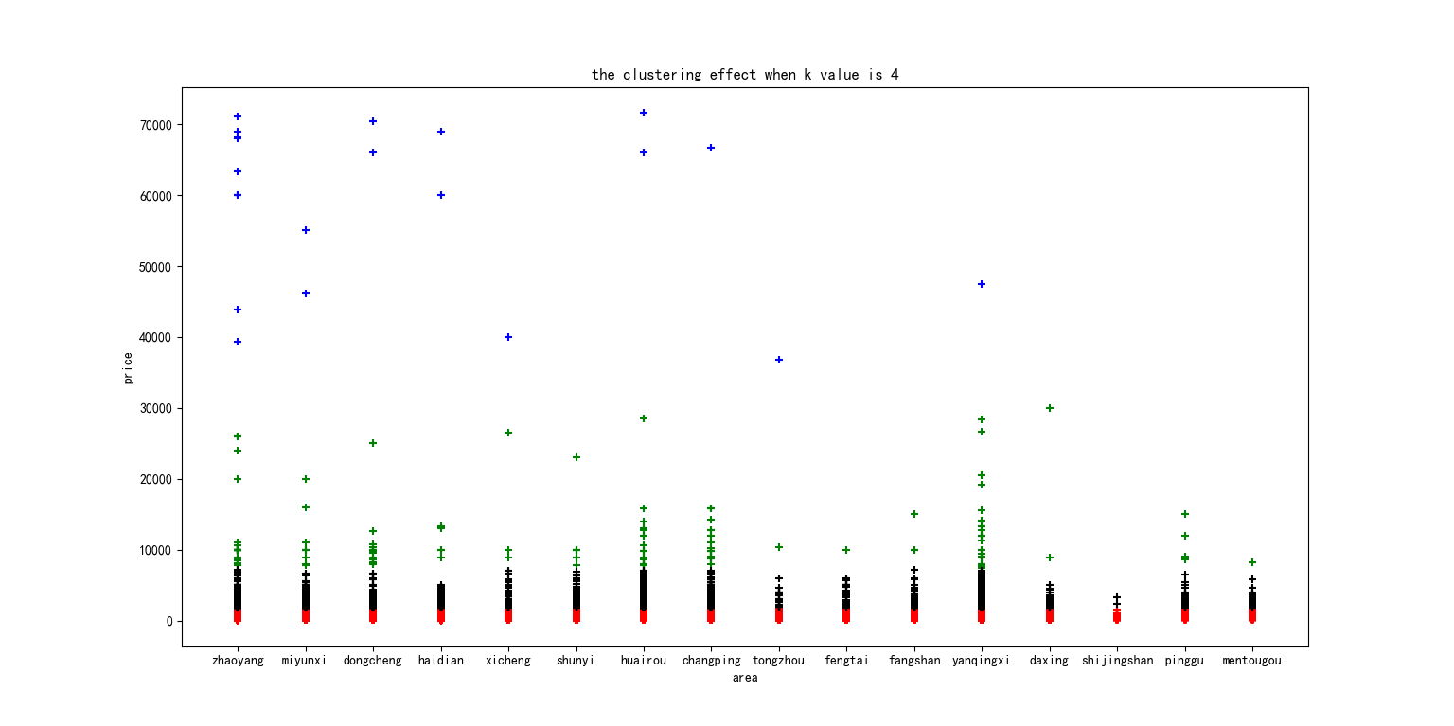

Slide 21
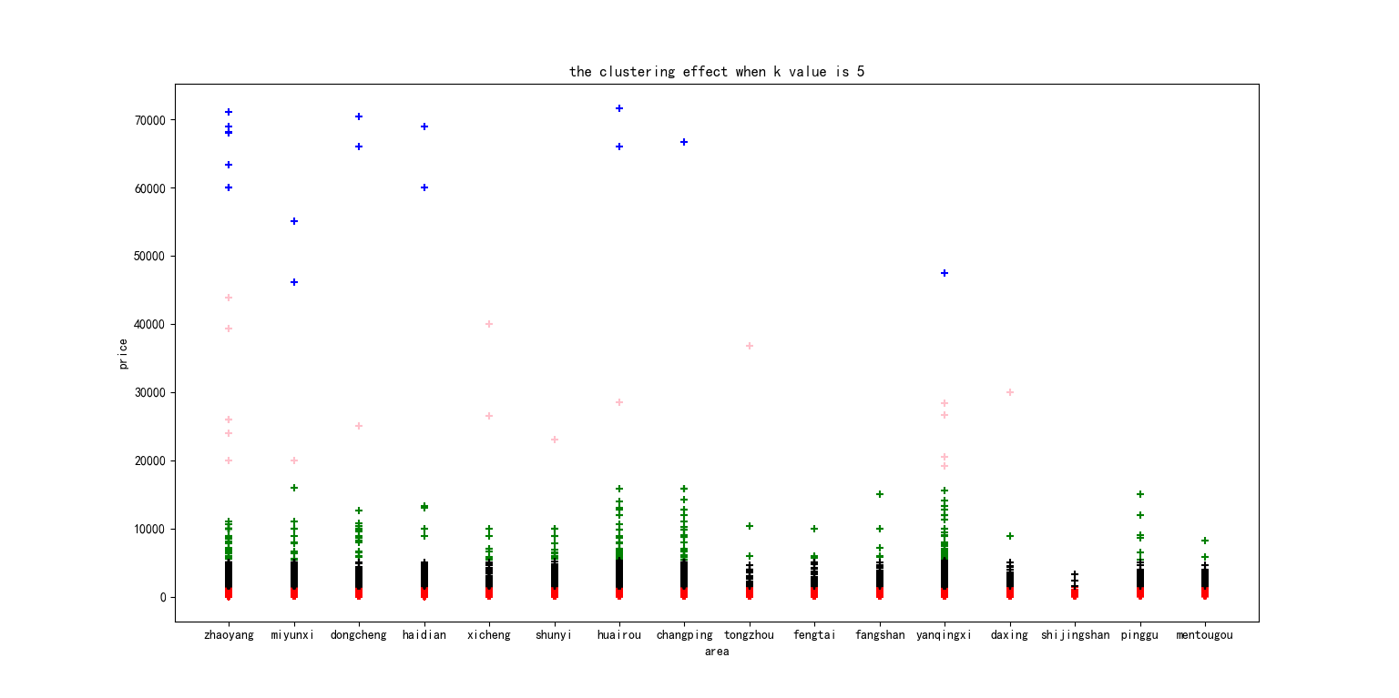

Slide 22
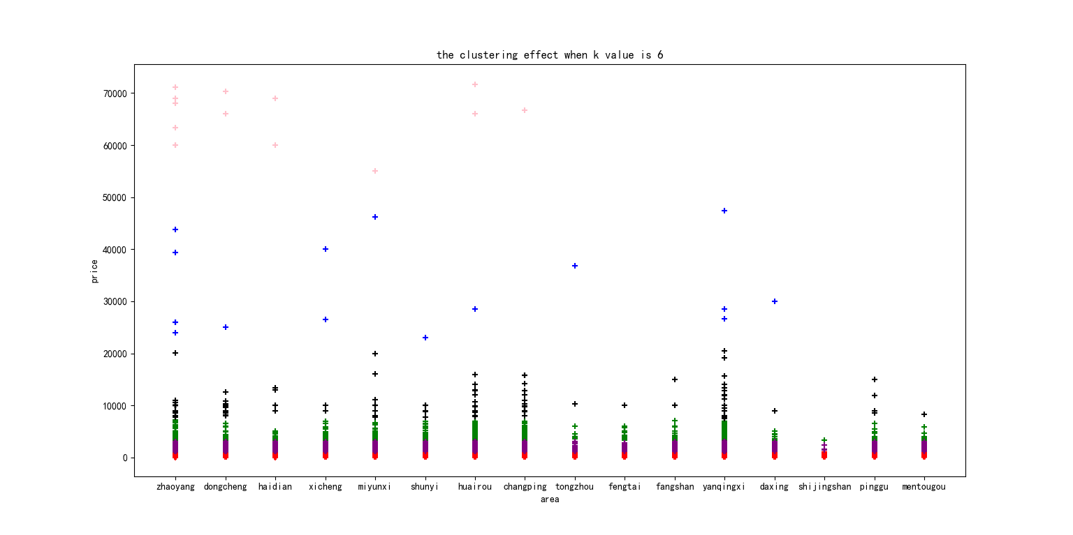

Slide 23
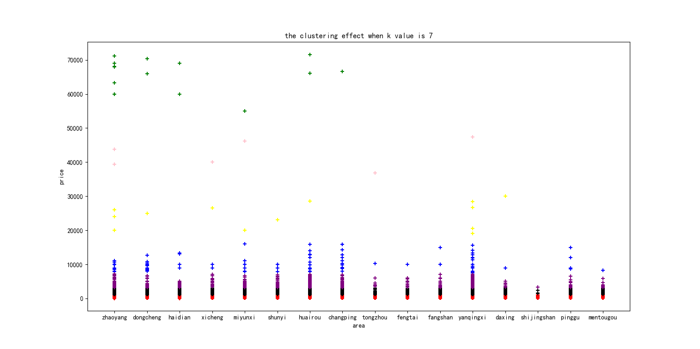

Slide 24
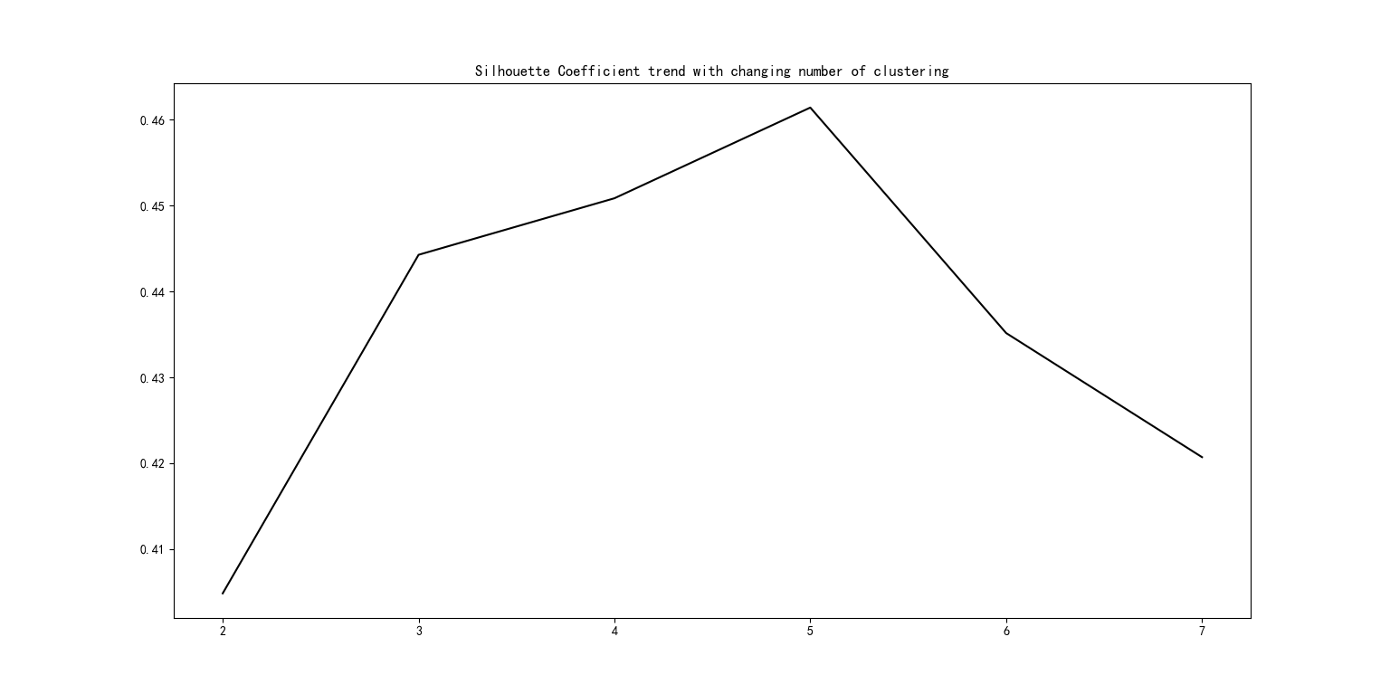
Summary:
When the number of cluster is 5, the Silhouette Coefficient is max

Slide 25
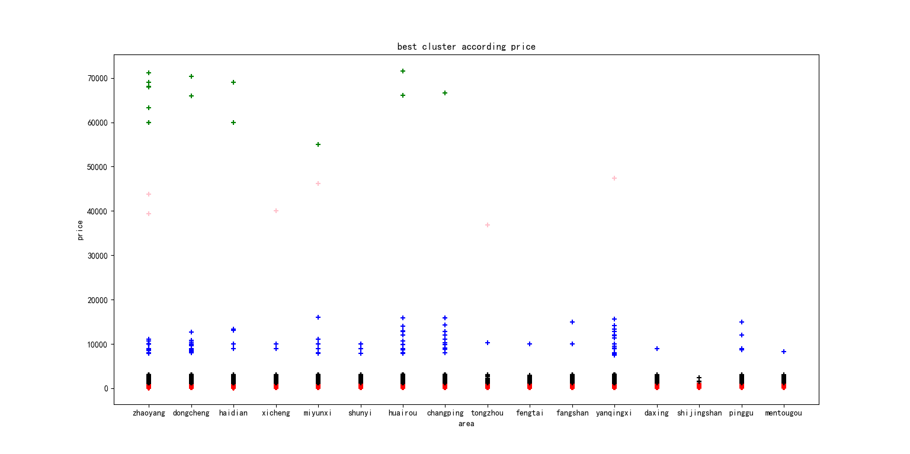
When the number of cluster is 5, the Silhouette Coefficient is max
Best number of cluster is 5

Slide 26
Reference
Gupta, S. (2019, January 5). Airbnb Rental Listings Dataset Mining. Retrieved from https://towardsdatascience.com/airbnb-rental-listings-dataset-mining-f972ed08ddec.
A Python Echarts Plotting Library. (n.d.). Retrieved from https://pyecharts.org/#/.
Python Data Analysis Library¶. (n.d.). Retrieved from https://pandas.pydata.org/.

